Slide 1
C♯ Dependency Injection Testing Entity Framework
Rasmus Lystrøm
Associate Professor
ITU
rnie@itu.dk

Slide 2
Agenda
Testing …
Dependency Injection
Testing Entity Framework

Slide 3
Testing …
Timing
Testing live databases is hard
Testing live full systems is hard
By transitivity: Testing … is hard…

Slide 4
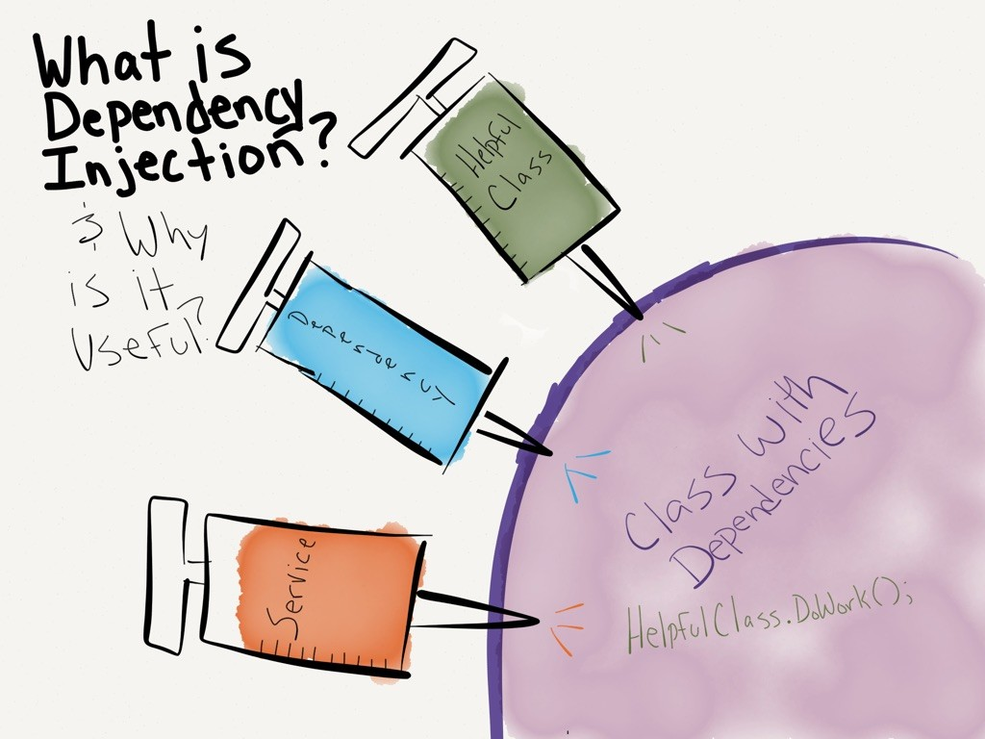
http://dwiardiirawan.com/index.php/2016/05/18/what-is-dependency-injection-and-what-are-the-advantage/

Slide 5
Dependency Injection (DI)
Software design pattern which implements Inversion of Control (IoC)
Constructor Injection
Property (setter) Injection
Interface Injection

Slide 6
Structered readable code Testable code Dependency Inversion Principle Separation of Concerns Rock SOLID!!! AWESOME!!
Pun intended

Slide 7
Programming to interface, not implementation…
public interface IFooService
{
bool Update(Foo foo);
}
public class FooService : IFooService
{
bool Update(Foo foo)
{
// Implementation
}
}

Slide 8

Using IFooService
public class Worker
{
public bool DoWork(FooDto fooDto)
{
IFooMapper mapper = new FooMapper();
var foo = mapper.Map(fooDto);
IFooService service = new FooService();
return service.Update(foo);
}
}

Slide 9
Constructor Injection (preferred)
public class Worker
{
private readonly IFooService _service;
public Worker(IFooService service)
{
_service = service;
}
public bool DoWork(FooDto fooDto)
{
// Implementation
}
}
Private readonly field
Initialize from constructor

Slide 10
Property Injection
Public setter
public class Worker
{
public IFooService Service { private get; set; }
public void DoWork(Foo foo)
{
Service?.Update(foo);
}
}
Is this King?

Slide 11
Interface Injection
public interface IServiceSetter<T>
{
void SetService(T service);
}
public interface IServiceSetter<T>
{
T Service { set; }
}

Slide 12
Interface Injection II
Interface
public class Worker : IServiceSetter<IFooService>
{
private IFooService _service;
public void SetService(IFooService service)
{
_service = service;
}
public void DoWork(FooDto fooDto)
{
// Implementation
}
}
Implement interface

Slide 13
Interface Injection III
Interface
public class Worker : IServiceSetter<IFooService>
{
public IFooService Service { private get; set; }
public bool DoWork(FooDto fooDto)
{
// Implementation
}
}
Implement interface

Slide 14
Best practices
Use Adapter to enable interface if needed
Use constructor injection
Use an IoC container
Program to interface
In a couple of weeks...

Slide 15
IoC Container
PM> Install-Package Microsoft.Extensions.DependencyInjection
IServiceCollection services = new ServiceCollection();
services.AddScoped<IService, Service>();
var provider = services.BuildServiceProvider();
var service = provider.GetRequiredService<IService>();

Slide 16
Unit Testing

Slide 17
Unit Testing Best Practices
Never test against a live database, file, or web service
Single Responsibility Principle
Atomic tests
Only test the
”System Under Test”
Use either mocks or stubs

Slide 18
Stub testing
Test stub
public class FooServiceFalseStub : IFooService
{
public bool Update(Foo foo)
{
return false;
}
}

Slide 19
Stub testing II
public class WorkerTests
{
[Fact]
public void DoWork_when_IFooService_Update_false_returns_false()
{
IFooService service = new FooServiceFalseStub();
using (var worker = new Worker(service))
{
var result = worker.DoWork(new FooDto());
Assert.False(result);
}
}
}

Slide 20
Mock testing
Mock using Moq
public class WorkerTests
{
[Fact]
public void DoWork_when_IFooService_Update_false_returns_false()
{
var mock = new Mock<IFooService>();
IFooService service = mock.Object;
using (var worker = new Worker(service))
{
var result = worker.DoWork(new FooDto());
Assert.False(result);
}
}
}

Slide 21
Mock testing II
Configure the mock
public class WorkerTests
{
[Fact]
public void DoWork_when_IFooService_Update_true_returns_true()
{
var mock = new Mock<IFooService>();
mock.Setup(m => m.Update(It.IsAny<Foo>())).Returns(true);
using (var worker = new Worker(mock.Object))
{
var result = worker.DoWork(new FooDto());
Assert.True(result);
}
}
}

Slide 22
Demo

Slide 23
Testing Entity Framework

Slide 24
In Memory Database
dotnet add package Microsoft.EntityFrameworkCore.InMemory
// In Memory Database:
var builder = new DbContextOptionsBuilder<MyContext>()
.UseInMemoryDatabase(databaseName: nameof(<name>));
// SQLite:
var connection = new SqliteConnection("DataSource=:memory:");
connection.Open();
var builder = new DbContextOptionsBuilder<MyContext>()
.UseSqlite(connection);
var context = new FuturamaContext(builder.Options);
context.Database.EnsureCreated();
dotnet add package Microsoft.EntityFrameworkCore.SqlLite

Slide 25
Best practices
Wrap in logical units/service classes/repositories
Don’t test built-in code…
Program to interface

Slide 26
Demo

